Slide 1
Phase 2 - System Development
Cougars Communications

Slide 2
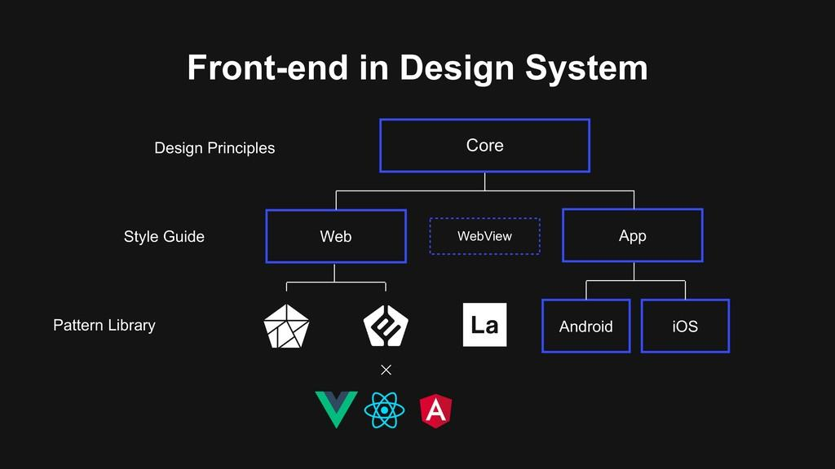
In this phase of the project we have began coding and designing the outline and idea of what our front end should look like.

Slide 3
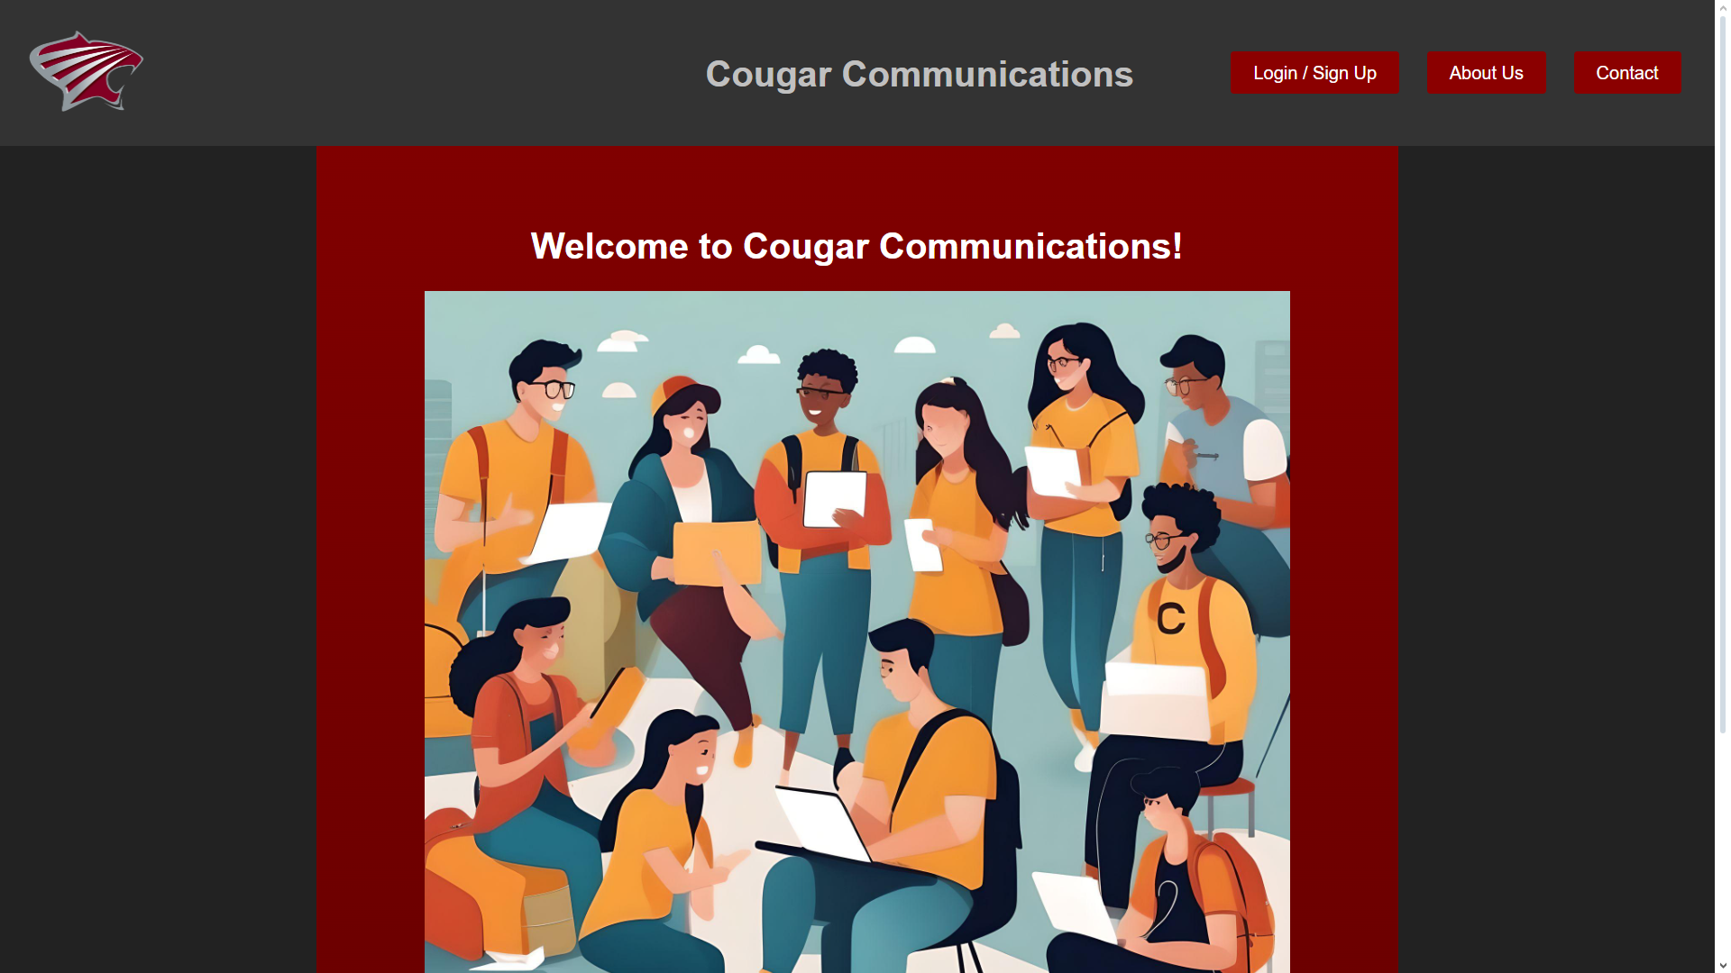
So far we were able to come up with a dark theme that incorporated the school colors of
We have an AI generated image on our homepage to show the diversity and connectivity we aim to achieve for the students at SCC.

Slide 4
The logo for Saint Charles Community College was picked as the logo and also serves as a return(home)button.
We have added buttons as navigation to our separate pages .In the future I plan to Change these pages and move the About US and Contact information to the footer of each page.
There is a simple welcome message for now which will later be changed to a more informational welcome paragraph.

Slide 5
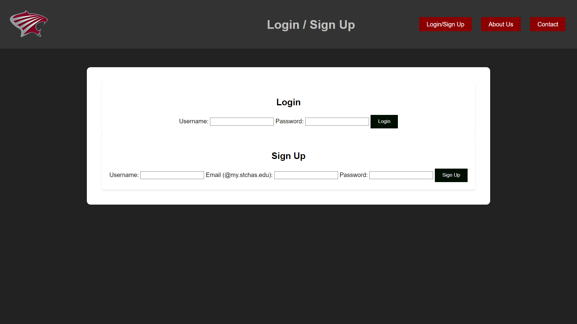
When pressing the login/sign up button you will be directed to this page which currently is functional in live preview mode.
The validation rules are set up for this page. This feature may be moving to the homepage in a login form in the future. Upon successful sign up or sign in, the user will be prompted to choose their profile picture and short bio.

Slide 6
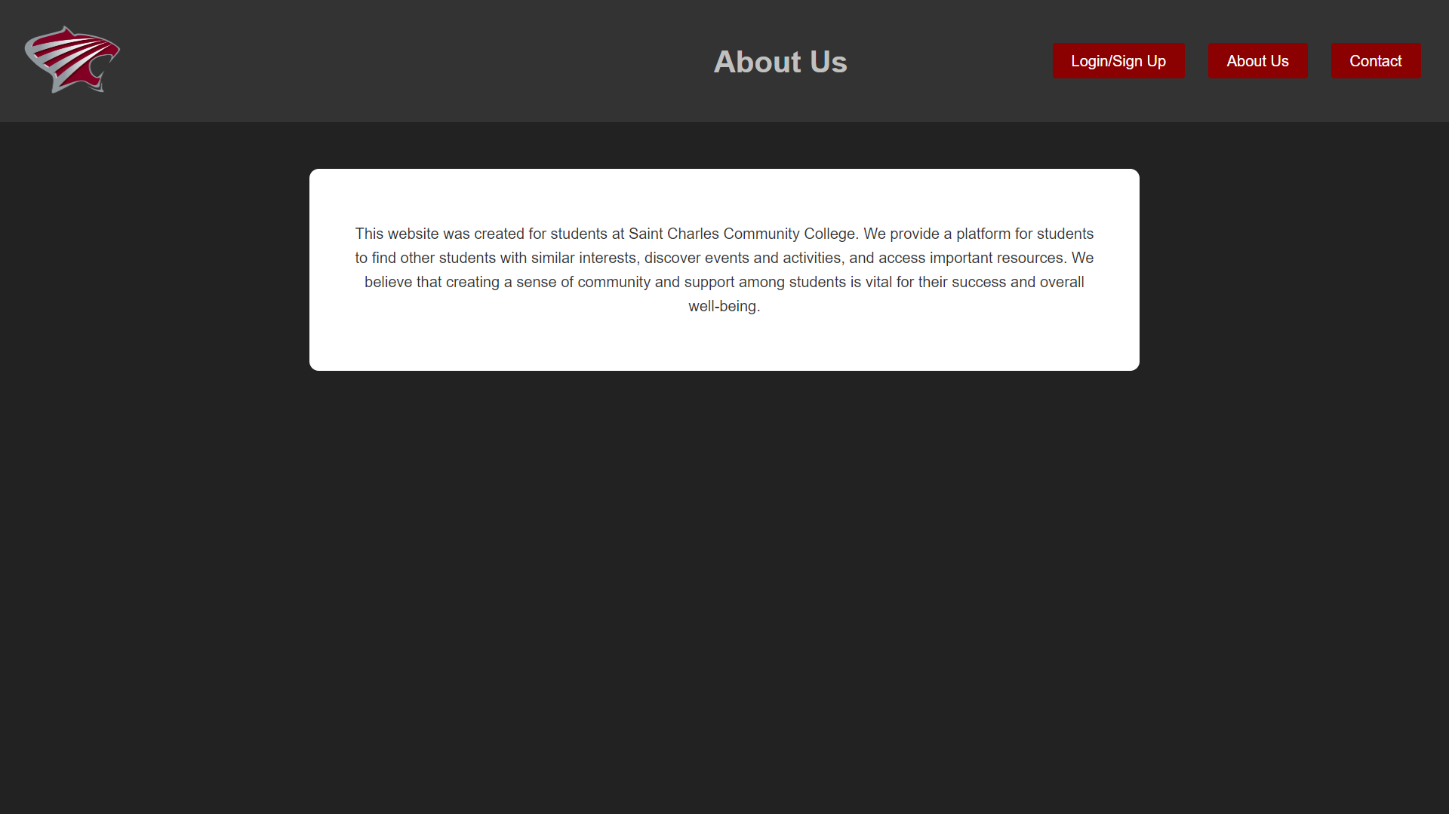
We have added a short description about why we have decided to create the website and what the goal of the website is. This page is not complete yet and will be updated in the next phase of the project.

Slide 7
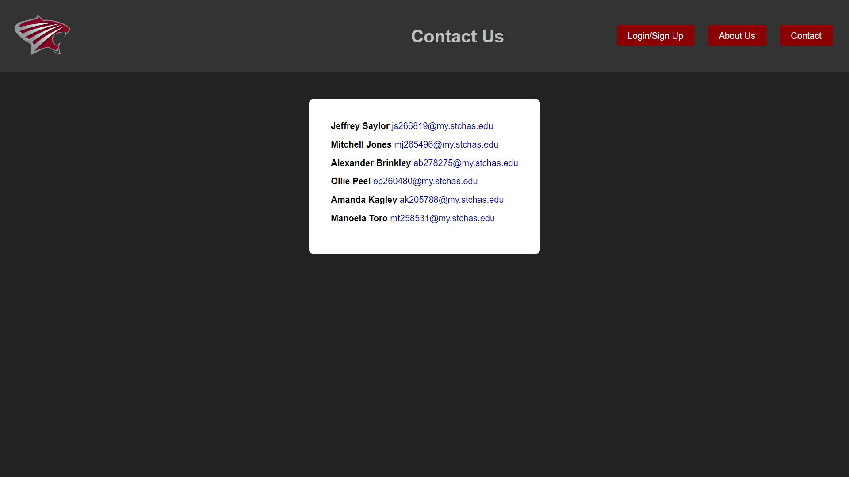
We have created this page of contact so that if anyone has questions or recommendations for the site they can contact any of the members of the creators. This information also shows the students that we are fellow students who are driven to make a positive difference.

Slide 8
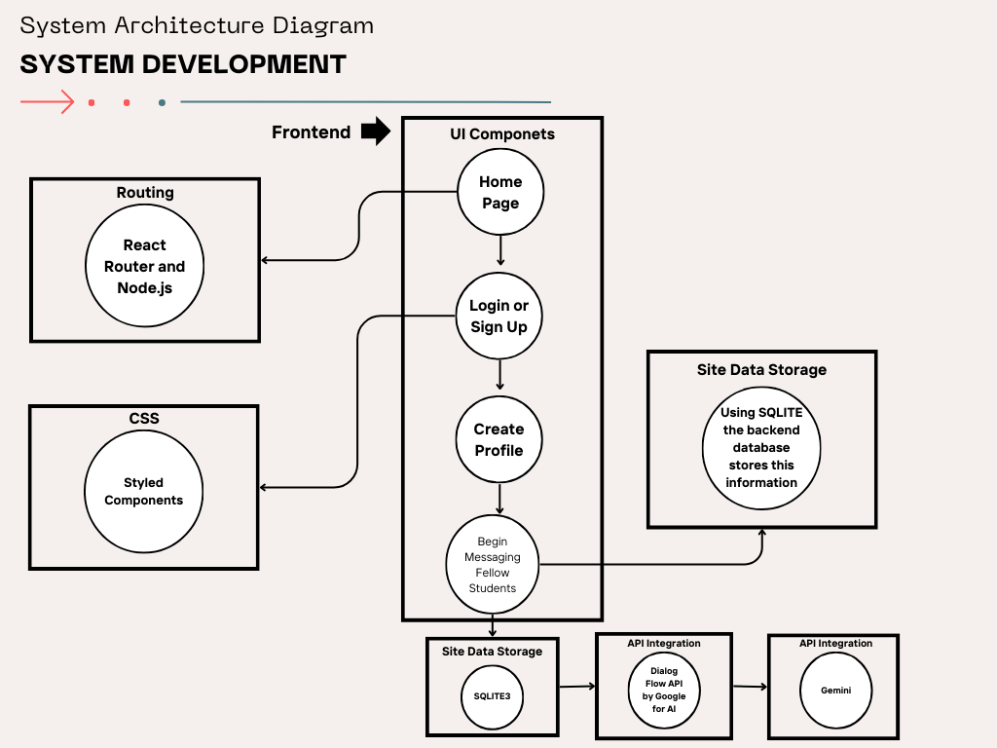
This is a rough and high overview of the system architecture of the front end development.

Slide 9
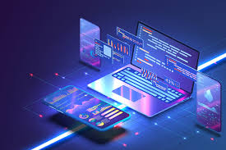
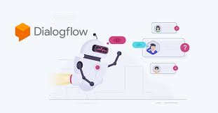
Technology !
Below you will find a list of different technology that we have added to our code to assist in the making of our application on the front-end:
Vite
React
npm.js
Gemini API
DialogFlow API
Dialog AI ChatBot

Slide 10

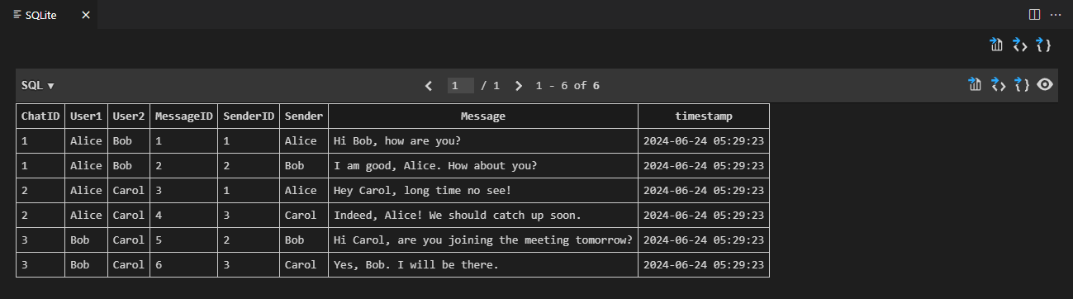
For our database, we have setup SQLite3. This engine is self-contained, lightweight and disc-based so it does not require its own server to run queries and manage a database file.
The information pictured here is data from our testing of the database running in our code.

Slide 11
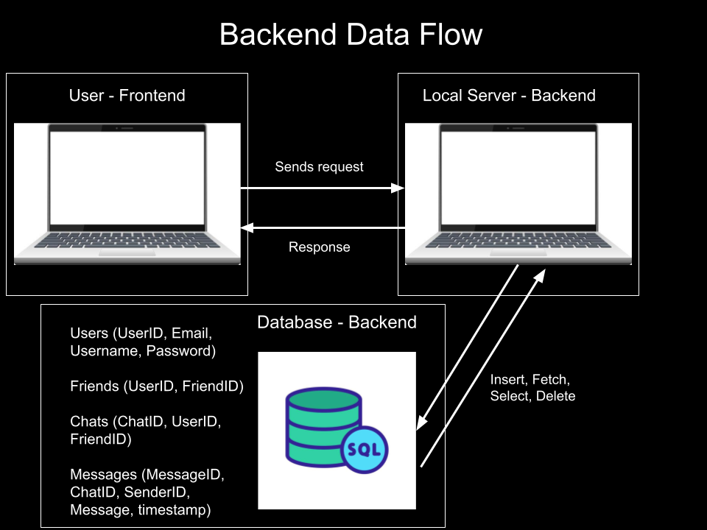

Slide 12
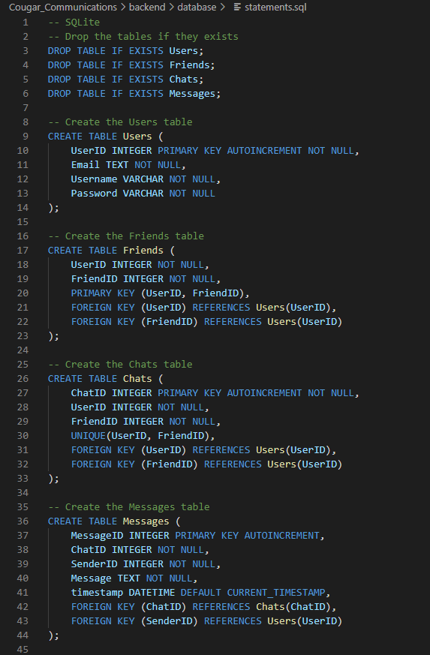
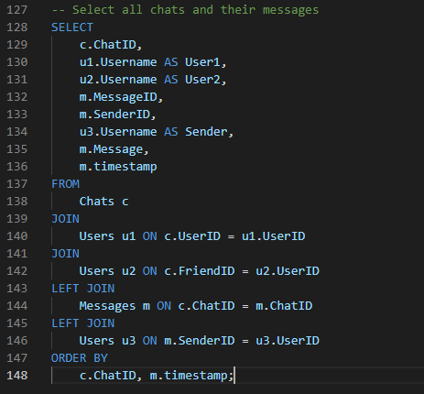
These examples are real code from our backend showing that we have begin to set up a functional database using the SQLite3.

Slide 13
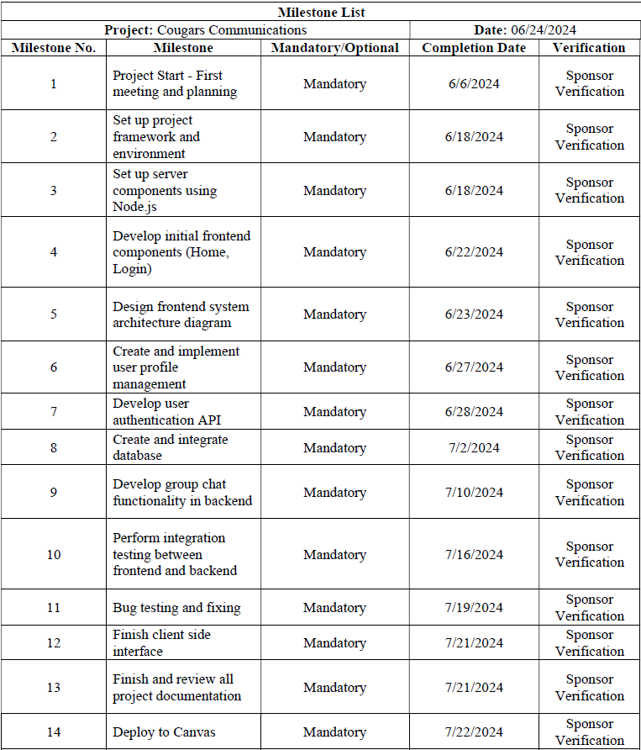
Project Timeline and Milestones
Each milestone represents a critical step toward our goal. This chart provides a visual timeline to track our progress.

Slide 14
Future Projections and Work Goals
With being new to react there was a lot we had to learn. Now having more knowledge and resources, we plan to restructure our code to ensure better and more accurate functionality.
Goals for the future :
Reformat the structure of our React app code.
Integrate the front end with the back end using APIs.
Enhance the UI with more information and appealing features.
Continue researching React to use it more effectively.
Future Projections:
Reformat code by 06/28/24.
Make the database, server, and API fully functional by 06/30/24.
Improve the UI by 07/05/24.
Have a better understanding on React and how it can assist us in the process of our creation - Ongoing research.

